Slide 1
Lecture No. 11 Corrosion Science
At the end of this lecture, student will be able to:
Explain the secondary factors contributing to corrosion rate
Describe corrosion control techniques
Discuss design and selection of materials for corrosion control
Explain Inorganic coatings – Anodizing and phosphating

Slide 2
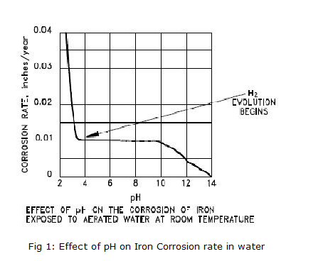
Secondary Factors Affecting Rate of Corrosion…
1. pH
Rate of corrosion increases with decrease in pH
At pH greater than 10, corrosion of iron practically ceases
Between pH 10 and 3 the presence of oxygen is required for
corrosion of iron
For example: Ship submerged in deep sea for many years remain
almost unaffected
If the pH is less than 3,severe
corrosion takes place even in
the absence of oxygen

Slide 3
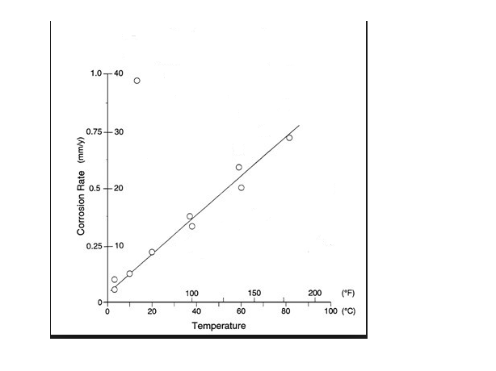
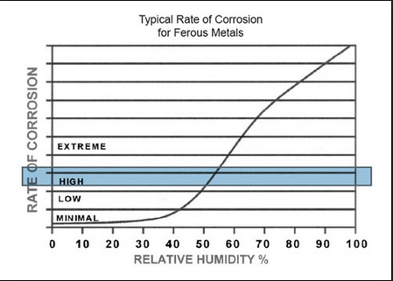
Secondary Factors Affecting Rate of Corrosion…
Temperature
Rate of corrosion increases
with temperature
Humidity
Rate of corrosion increases
with increase in humidity

Slide 4
Secondary Factors Affecting Rate of Corrosion…
Presence impurities
SO₂ is common in places where coal or oil is burnt. Severe corrosion of metals occurs in such atmosphere
When the relative humidity is high the corrosion is far greater
For example:
Iron in an atmosphere of 0.01% SO₂ and relative humidity less than 50%, it shows negligible rusting
At the same concentration of SO₂ and at 90% humidity the iron gets rusted fully in a day

Slide 5
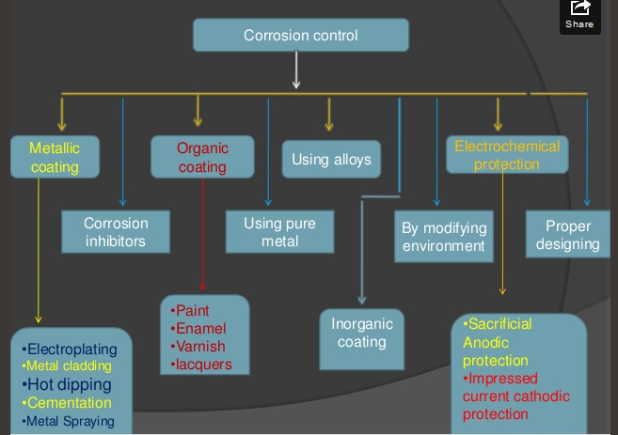
Corrosion Control

Slide 6
Corrosion control
Corrosion can be controlled by:
Proper design and selection of materials
Protective coatings
Inorganic coatings – Anodizing and phosphating
Organic coating – Paint and enamel
Metal coating – Anodic metal coating (Galvanizing) – Cathodic metal coating (Tinning)
Cathodic protection - Sacrificial anode method
- impressed current method
Using Corrosion inhibitors – Anodic inhibitor
-Cathodic inhibitor

Slide 7
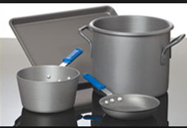
Design and selection of materials
Selection of proper materials
Avoiding the use of two dissimilar metals
Anode material area shall be larger to cathode area as far as possible
Notes:
There should not be gaps at the joints as this causes differential aeration corrosion
Stressed materials should be annealed to avoid stress corrosion
Fabrications should have smooth edges and recesses to avoid stress corrosion
Fabrications should be supported on legs instead of large blocks as this ensures aeration all around.

Slide 8

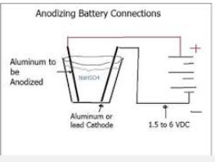

Protective coatings
Inorganic coatings
Anodizing: when a metal like Al, Ti, Mg etc are made anode in presence of chromic acid , oxalic acid, Sulphuric acid, a thin layer of oxide is formed which acts as protective layer. This process is known as anodizing. This passiveness of the metal reduces corrosion
3- 10% chromic acid, 40V, 30⁰C
2Al + 3H₂O → Al₂O₃ + 3H₂

Slide 9
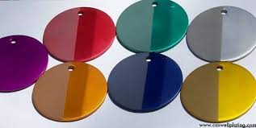
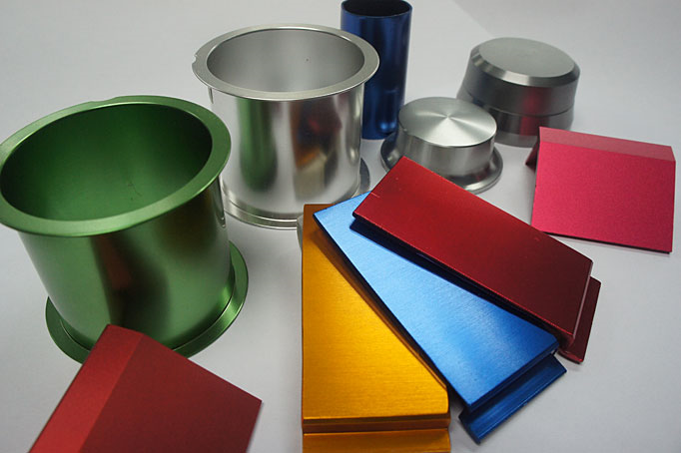
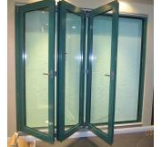
Protective coatings…
Application: Used in computer hardware, in aircrafts, window frames, utensils etc.

Slide 10
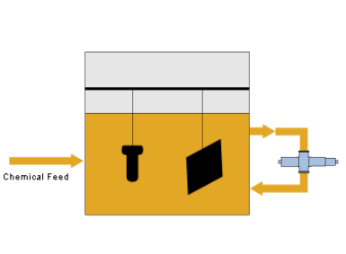
Protective coatings…
(ii) Phosphating:
Process of depositing of phosphate on metal surface
Steel, zinc, and aluminum objects that needs to be painted are generally given an undercoat of phosphate
Process:
- Bath: A mixture of Free Phosphoric acid, a metal(Zn or Mn) Phosphate
- Oxidizing agent: Sodium nitrate(NaNO₃)
- PH; 1.8-3.2
- Temperature: 35 ºC

Slide 11
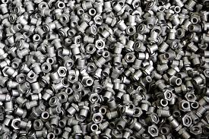
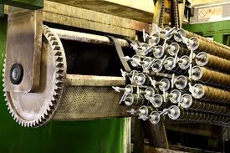
Phosphatizing
Thin porous film of phosphate layer is formed on the surface of the object
This porous surface serve as excellent base for paints
Deposition of the metal phosphate on the surface of the metal
3Fe + 2H₃PO₄ → Fe₃(PO₄)₂ + 2 H₂
Application: under coat for washing machines and refrigerators before panting gives good corrosion resistance

Slide 12
Summary
Secondary factors contributing to corrosion rate are pH, temperature, conductance of medium, humidity, presence of impurities in environment
Corrosion control techniques: Inorganic coatings – Anodizing and phosphating
Design and selection of materials for corrosion control

